Slide 1
Customer Segmentation and Profiling Analysis
Final Project Proposal
Guided by:
Dr. Chris Asakiewicz
Group – 7
Revanth Vemula
Harshil Chauhan
Raghava Sagar

Slide 2
Research Question
Stakeholders want to segment audience based on demographic and/or behavioral data to create more targeted messaging that speaks directly to their needs and interests.
Main goal here is to help sales team to increase Total amount spent by each customer on average.
Primary research questions to handle this requirement are:
How do different personality traits correlate with customer behaviors.
popular product combinations and preferences for each customer segment to optimize product offerings.
Analyze customer responses to past promotional campaigns to understand their preferences to help design more effective promotions in the future.

Slide 3
Introduction and Problem Background
Customer Personality Analysis is a detailed analysis of a company’s ideal customers. It helps a business to better understand its customers and makes it easier for them to modify products according to the specific needs, behaviors and concerns of different types of customers.
This helps a business to modify its product based on its target customers from different types of customer segments. For example, instead of spending money to market a new product to every customer in the company’s database, a company can analyze which customer segment is most likely to buy the product and then market the product only on that segment.

Slide 4
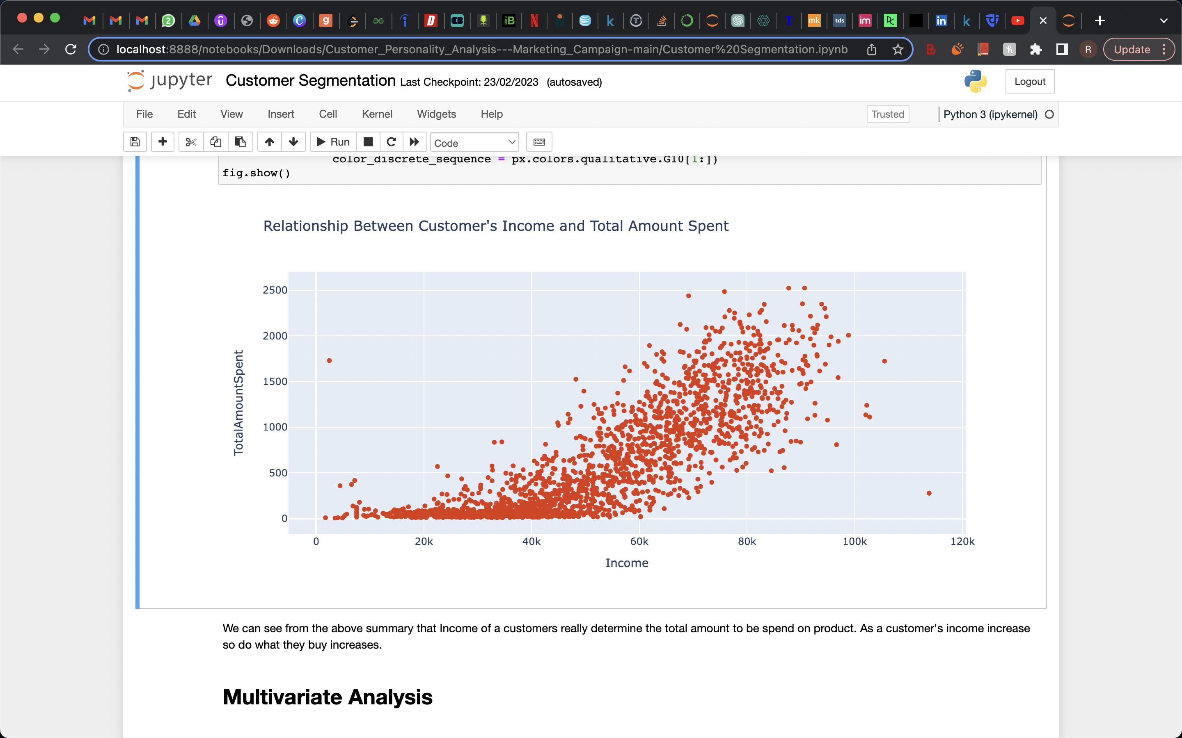
Results from Exploratory Analysis
Income has shown to be an important indicator that determined the amount a customer will spend.

Slide 5
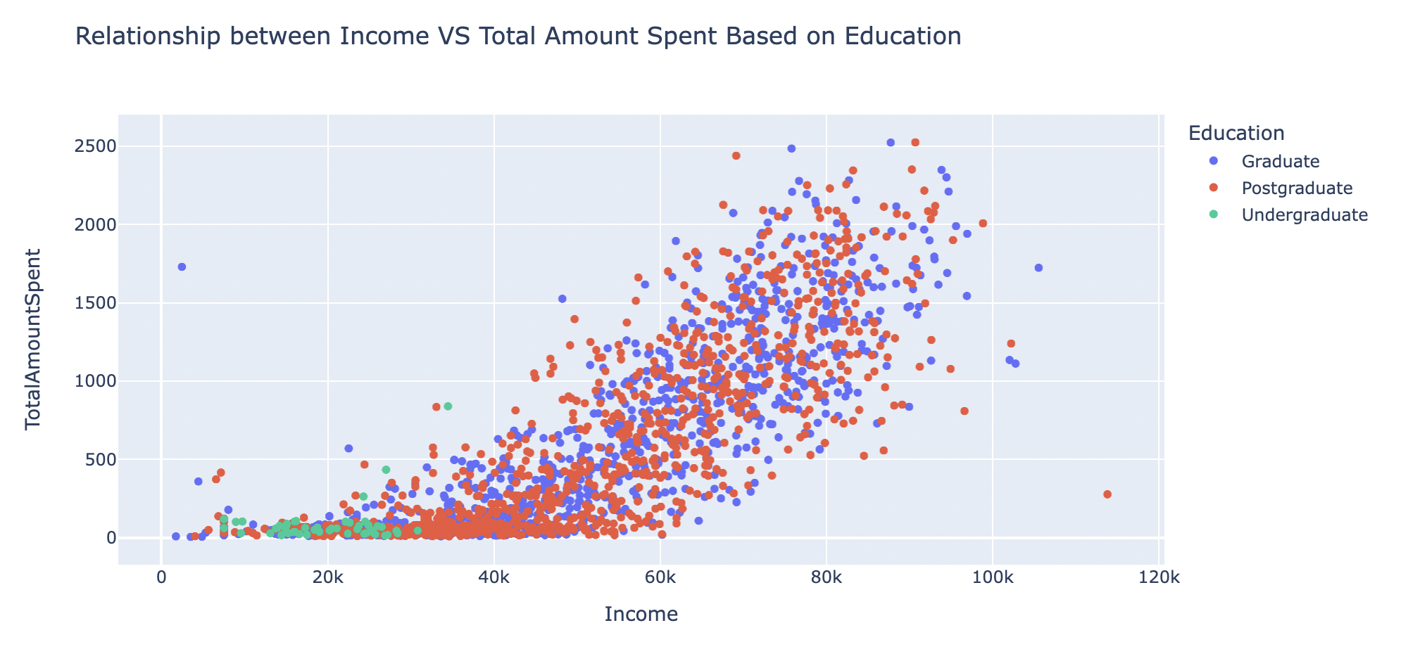
For Education we noticed customers with graduate education level and above tends to spend 12 times higher than those customers with undergraduate education level. The reason for this is because customers with graduate education level and above earns above 2 times than customers with undergraduate education level.

Slide 6
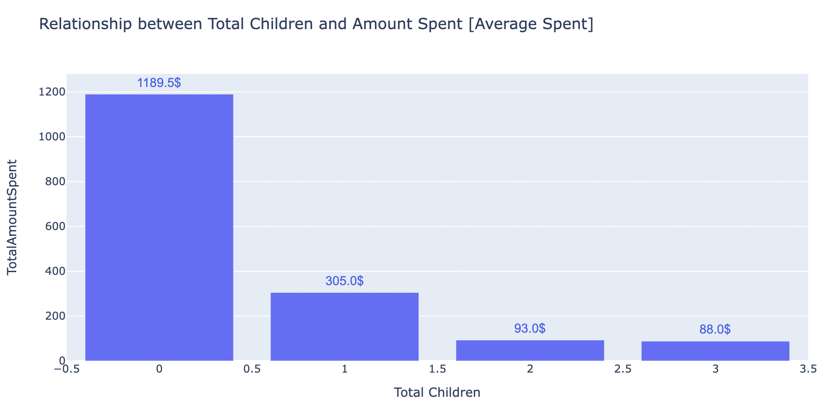
we noticed a trends in terms of total children and total amount spent. We saw that on average there was a decline on the amount spent as the total number of children increases so do the amount spent on average reduces.

Slide 7
Data Mining and Analysis Methodology
Clean and preprocess data using Python.
Use Python, Tableau for exploratory data analysis.
Perform customer segmentation using Python.
Build predictive models using Python.
Communicate results with visualizations and reports.

